Slide 1

Cash Flow Statement Part 1 –Class

Slide 2

Key Points from the Video
Net income and operating cash flow are: a) equal b) Not the same
The cash flow statement reconciles changes in cash between balance sheet dates
Cash flows are classified into operating, investing and financing activities

Slide 3
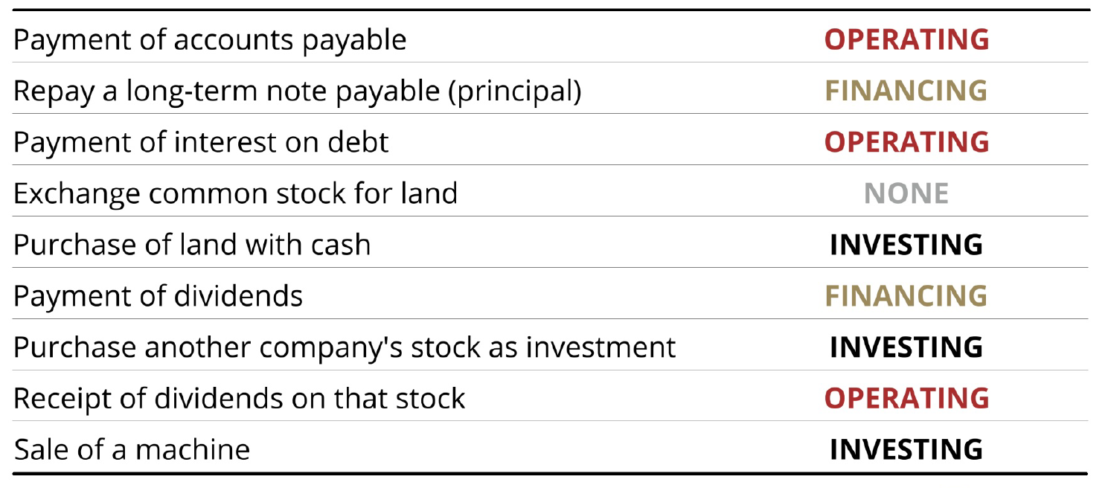
Identify the CF Activity Operating, Investing, or Financing?

Slide 4

Questions?

Slide 5
Reminders
Investments:
Buy/sell = investing
Receive interest revenue = operating
Receive dividends = operating
Debt:
Issue/retire = financing
Pay interest expense = operating
Stock:
Issue/repurchase stock = financing
Pay dividends = financing
Interest & Dividends = Operating
UNLESS you are
PAYING Dividends = Financing
Notes:
Interest and dividend revenue on investments (assume not in business of investing)
-derived from investing
-but treated as operating
Interest expense from borrowing
-derived from financing
-but treated as operating
-logic:
*you can finance infrastructure with borrowing, purchase, or leases
*buy/lease: rent, depreciation, interest, etc. all in operating
*try to be consistent across all financing (all operating)
Dividends paid=financing (remember dividends received=operating)
3 items in net income -> all in O
-int rev
-int exp
-div revenue (received)s

Slide 6
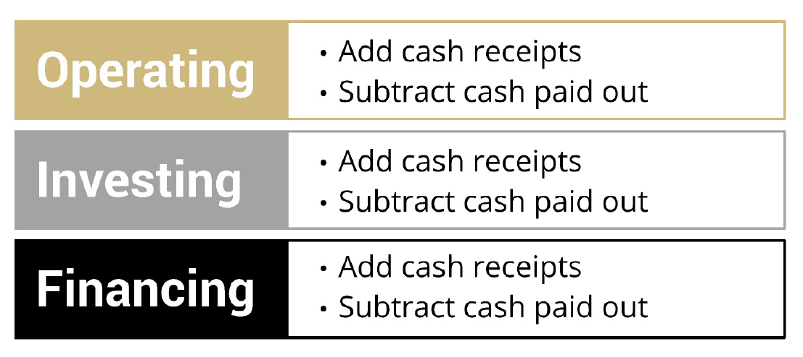
Direct Method vs Indirect

Slide 7
CFS Format: Direct Method
Follow the Cash!

Slide 8
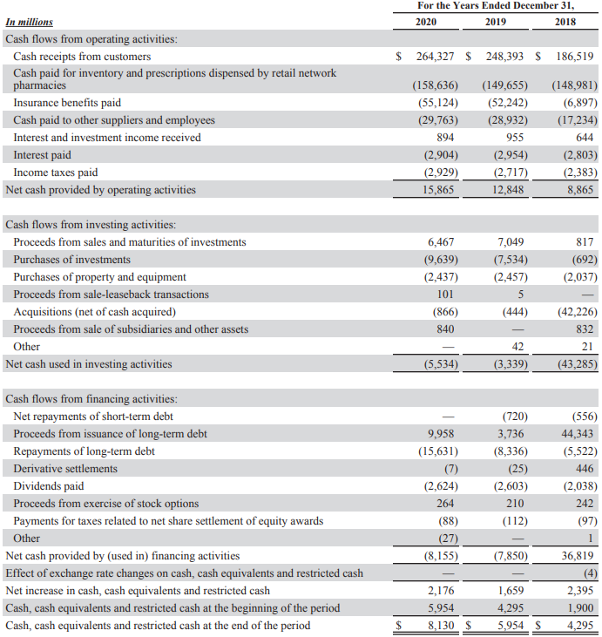

Direct Method: CVS (2020 CFS)
Change in Cash
+
Beginning Cash Balance
Ending Cash Balance

Slide 9
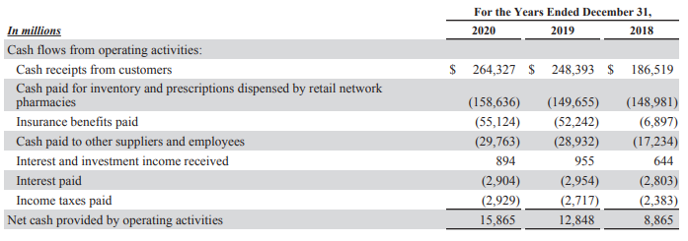
Direct Method: Operating

Slide 10
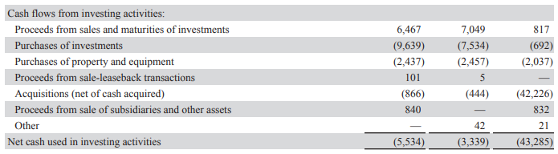
Direct Method: Investing

Slide 11
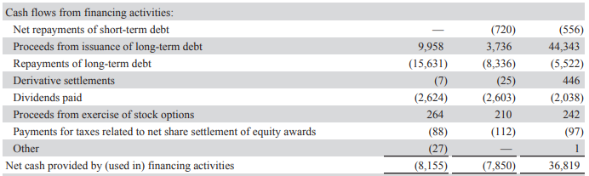
Direct Method: Financing

Slide 12
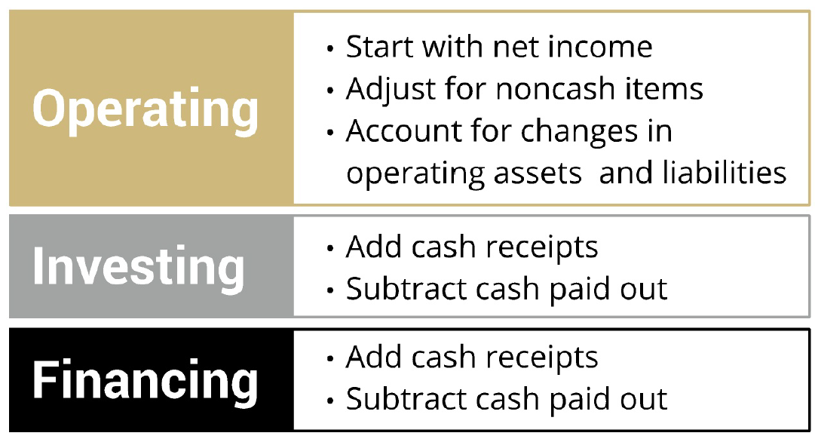
Formats: Indirect Method
99% of the time!
Follow The Cash
* Always Direct!

Slide 13
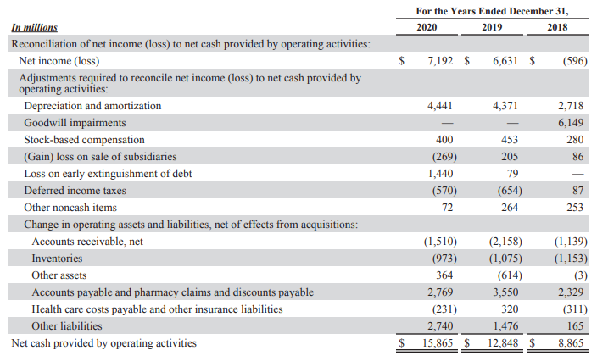
Indirect Method: Operating
Totals are same as in direct method

Slide 14
Indirect Method Steps
Goal
Start with Net Income and
remove non-cash revenues and expenses
(In other words, net income is our starting estimate of operating cash flow, but it includes some non-cash items, and doesn’t include other cash items)

Slide 15
Indirect Method: Operating
Non-Cash Number!!!
Start with net income
*** Make 3 Types of Adjustments to Net Income ***
Income Statement Items:
Gains/Losses (sell LT assets: PP&E, intangibles, investmts)
Non-Cash Expenses (Depreciation/Amortization, Stock Compensation, etc)
Changes in operating assets (B/S, typically current)
Changes in operating liabilities (B/S, typically current)
Net Cash from Operations
Opposite
(of Effect)
Opposite
(of Change)
Same
(as Change)

Slide 16
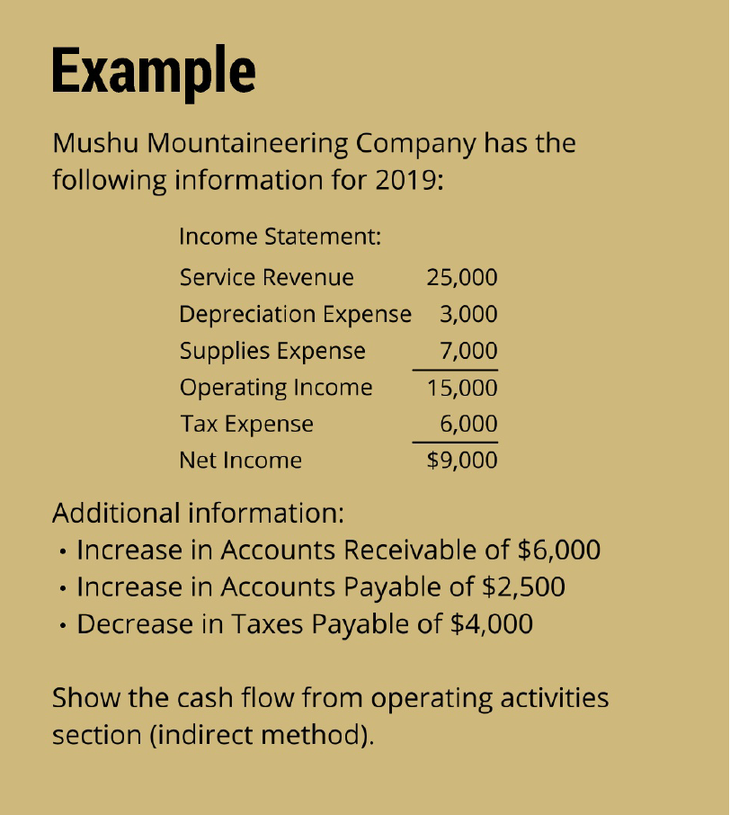
Solution:
Net Income 9,000
Non-cash adj:
+ Depr Exp 3,000
(-) Chg Op Assets:
- Incr A/R (6,000)
(+) Chg Op Liabilites:
+ Incr A/P 2,500
+ Decr Tax Pay (4,000)
Operating Cash Flow 4,500

Slide 17
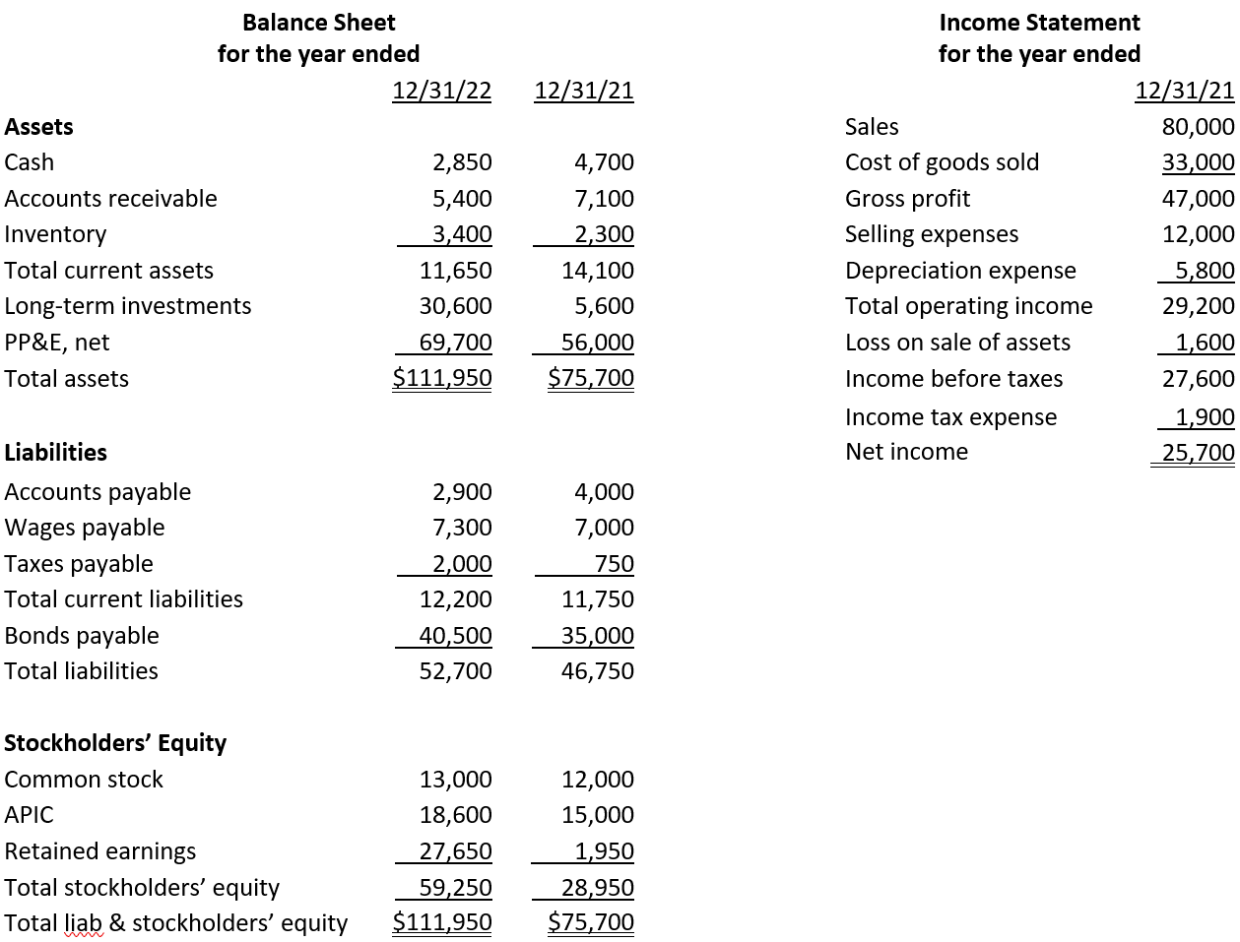


In-class problem
From the records of Mulan Corp. on December 31, 2024:
Prepare the Cash Flow from Operating Activities section using the Indirect Method.

Slide 18
Indirect Method: Operating
Non-Cash Number!!!
Start with net income
*** Make 3 Types of Adjustments to Net Income ***
Income Statement Items:
Gains/Losses (sell LT assets: PP&E, intangibles, investmts)
Non-Cash Expenses (Depreciation/Amortization, Stock Compensation, etc)
Changes in operating assets (B/S, typically current)
Changes in operating liabilities (B/S, typically current)
Net Cash from Operations
Opposite
(of Effect)
Opposite
(of Change)
Same
(as Change)

Slide 19
Indirect Method
Start with net income (accrual number)
Subtract non-cash gains
Gains on sales of long-term assets (PP&E and intangibles)
Gains on sales of investments
Add back non-cash losses/expenses
Losses on sales of long-term assets (PP&E and intangibles)
Losses on sales of investments
Depreciation and amortization
2. Subtract changes in operating assets
3. Add changes in operating liabilities
Net Cash from Operations

Slide 20
Cash Flow Intuition – operating asset
Example: Change in Accounts Receivable (Opposite)
Firm sells $100 of goods on account
Journal entry?
A/R (B-A) 100
Revenue (I-R) 100
Net Income goes up but no effect on Cash

Slide 21
Cash Flow Intuition – operating asset
Example: Change in Accounts Receivable (Opposite)
Firm collects $50 from previous sale
Journal entry?
Cash (B-A) 50
A/R (B-A) 50
Cash goes up but no effect on Net Income

Slide 22
Cash Flow Intuition – operating liability
Example: Change in Salaries Payable (Same)
Firm has employee salaries of $10,000 for December. Company will pay employees on January 5th
Journal entry?
Salary Expense (I-E) 10,000
Salary Payable (B-L) 10,000
Net Income goes down but no effect on Cash

Slide 23
Cash Flow Intuition – operating liability
Example: Change in Salaries Payable (Same)
Firm pays employee salaries of $10,000 from previous month
Journal entry?
Salary Payable (B-L) 10,000
Cash (B-A) 10,000
Cash goes down but no effect on Net Income

Slide 24

Optional Problem?
Next Class: Cash Flow 2
In-Class Problem: Do Operating Section

Slide 25

Takeaways
Two cash flow reporting methods: Direct and Indirect
Investing and Financing are always direct method
Operating can be either (but usually indirect).
If use direct must also report indirect.

Slide 26
Things to do…

Slide 27
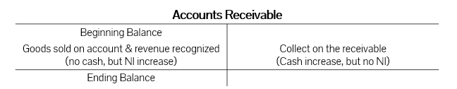

Cash Flow Intuition – operating asset
Example: Change in Accounts Receivable
If A/R increases, firm had more revenue than cash collected, so subtract the increase from net income.
If A/R decreases, firm collected more cash than revenue recognized, so add the decrease to net income.

Slide 28
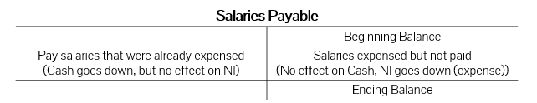
Cash Flow Intuition – operating liability
Example: Change in Salaries Payable
If payable increases, firm had more expense than cash paid out, so add the increase from net income.
If payable decreases, firm paid out more cash than expensed, so subtract the decrease to net income.

